Slide 1
UNIT -3 Power BI for Data Transformation and Visualization

Slide 2
Syllabus
Introduction to Power BI: Power BI components, Power BI Desktop and Power BI Service, Connecting to data sources. Data Transformation and Modeling in Power BI: Data loading and shaping using Power Query Editor, Data modeling and relationships, Calculated columns and measures, DAX (Data Analysis Expressions) language fundamentals. Creating Interactive Reports and Dashboards in Power BI: Visualizations and chart types, formatting and customization options, Drill-through and drill-down capabilities, Filters, slicers, and hierarchies.

Slide 3
Power BI components
Power Query
Power Pivot
Power View
Power Map
Power Q&A
Power BI Desktop
Power BI Website
Power Mobile Apps.

Slide 4
Power Query
Power Query is one of the important components of Power BI.
This can be included in your Excel or can be used as a component of the Power BI Desktop.
Using Power Query, you can delete data from numerous data sources and extract data from a wide range of different databases like Oracle, SQL Server, MySQL, and other different databases.
You can also fetch data from records like text files, CSV files, or Excel files.

Slide 5
Power Pivot
Power Pivot is a data modeling and calculation engine.
It is used for modeling simple and complex data. In Power Pivot, you can set or create relationships between different tables and calculate values that can be viewed in Pivot tables.
It provides you with a huge space to create your design. The language used by Power BI Pivot is Data Analysis Expression (DAX), which is a strongly functional language, and all your calculations are done here.

Slide 6
Power View
Power View is a data visualization technology that lets you create interactive charts, graphs, maps, and other visuals that bring your data to life.
Power View is available in Excel, in SharePoint, SQL Server, and Power BI.

Slide 7
Power Map
A power map lets you discover insights you might not see in traditional two-dimensional (2-D) tables and charts.
With Power Map, you can plot geographic and temporal data on a 3-D globe or custom map, show it over time, and create visual tours you can share with other people.

Slide 8
Power Q&A
The Q&A question box is where you type your question using natural language.
Power BI Q&A supports the following configurations of data sources in the Power BI service:
Import mode.
Live connect to Azure Analysis Services.
Live connect to SQL Server Analysis Services (with a gateway)
Power BI datasets.

Slide 9
Power BI Desktop
Power BI Desktop is a free application you install on your local computer that lets you connect to, transform, and visualize your data.
With Power BI Desktop, you can connect to multiple different sources of data, and combine them (often called modeling) into a data model.

Slide 10
Power BI Website
Power BI is a collection of software services, apps, and connectors that work together to help you create, share, and consume business insights in the way that serves you and your business most effectively.

Slide 11
Power Mobile Apps
Power Apps is a suite of apps, services, and connectors, as well as a data platform, that provides a rapid development environment to build custom apps for your business needs.
To run PowerApps on your device there are some recommended specs to ensure that the App runs smoothly to make sure you get the best user experience.
For Android, it is recommended to have Version 7 or higher devices with at least 4 GB of RAM and for iOS devices Version 10 or higher devices with at least 2 GB of RAM.

Slide 12
Power BI Desktop and Power BI Service
Power BI Desktop is the system version of Power BI present in the local system, It is downloaded as a free application.
The comprehensive report authoring tool for report designers is Power BI Desktop.
You can connect to many data sources through the desktop and then turn the data into a data model.
The addition of visuals based on the data model is the last step in the report generation process.
Whereas PowerBi service is a cloud-based service where users view and interact with the reports.
The Power BI reports are published to the Service by report creators using the Desktop application.
Users of the Service can exchange and collaborate with coworkers while editing reports and developing visualizations using the current data model.

Slide 13
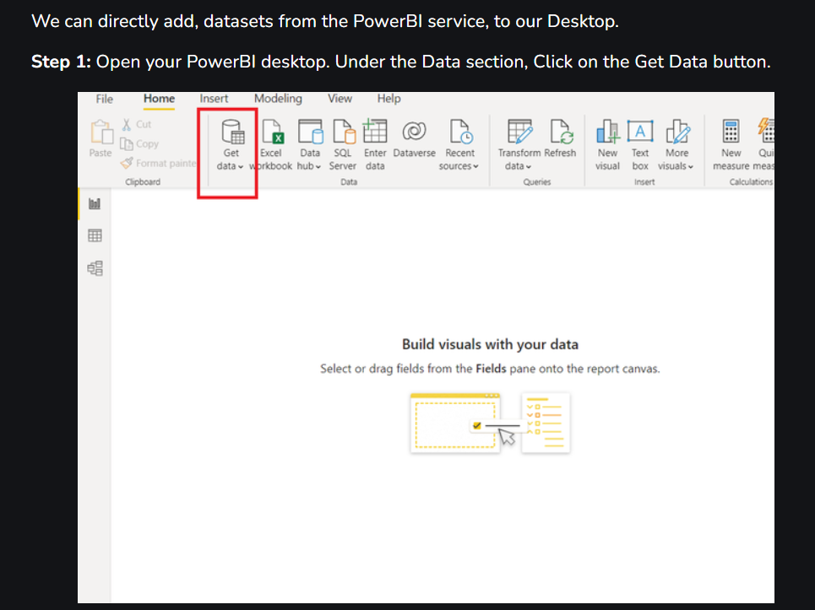

Slide 14
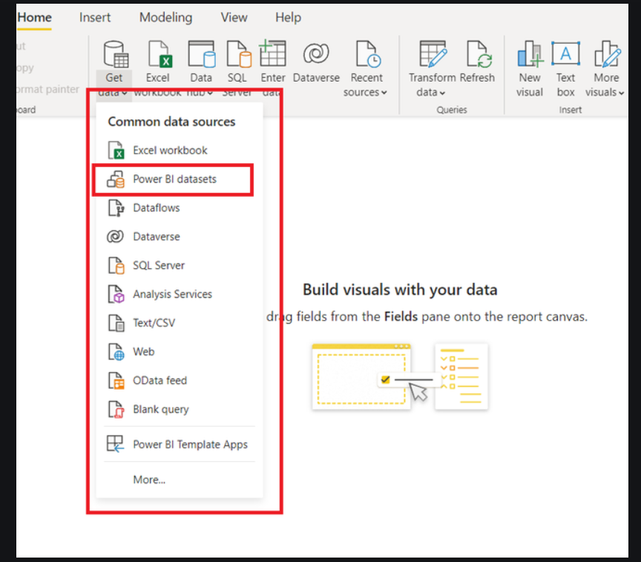
Step 2

Slide 15
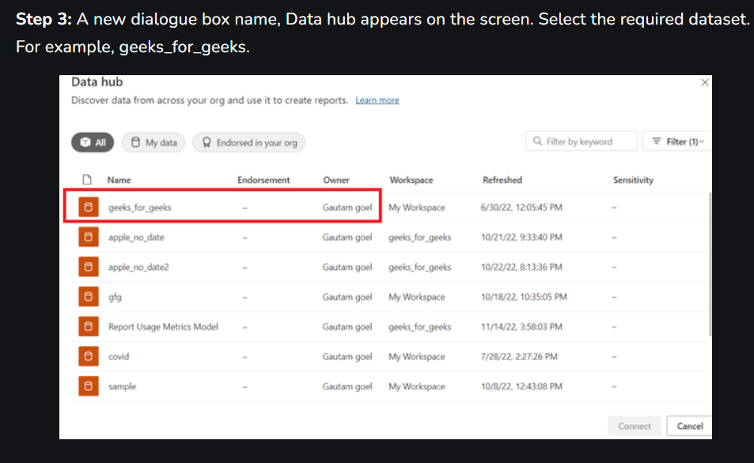

Slide 16
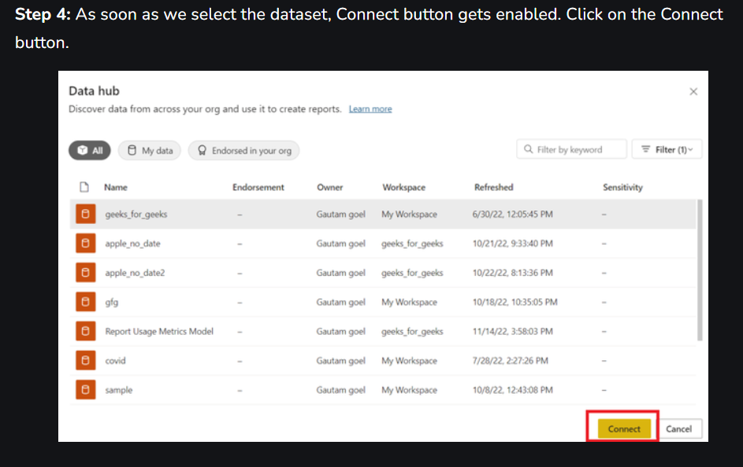

Slide 17
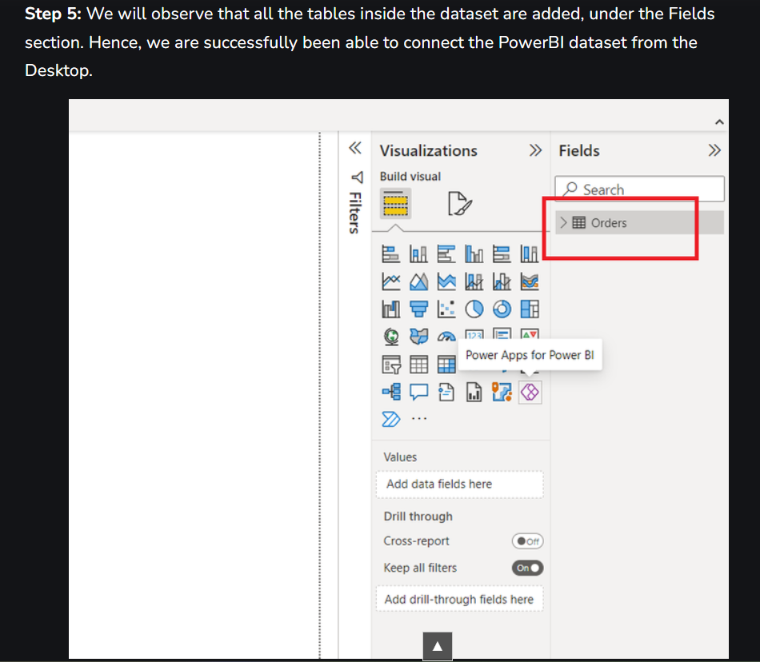

Slide 18
Connecting Power BI Desktop With Power BI Service
The entire connection process, consists of two parts, the first part is to create an account on the Power BI Service, this step could be skipped if you already have an account with the Power BI service.
The second part is to publish a report on the Power BI service from the Power BI desktop.

Slide 19
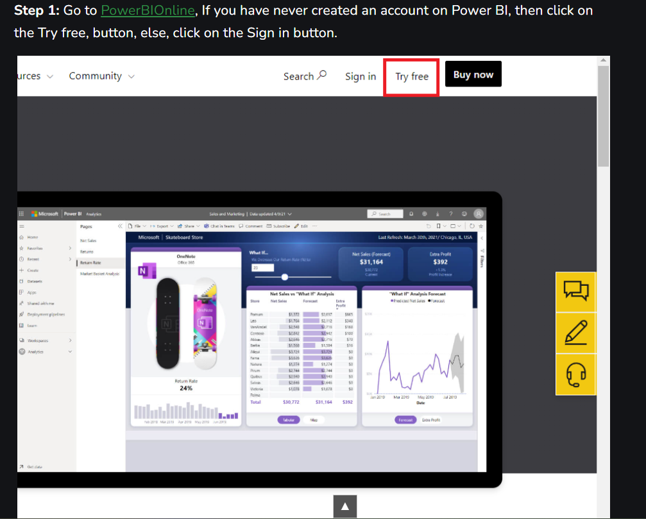

Slide 20
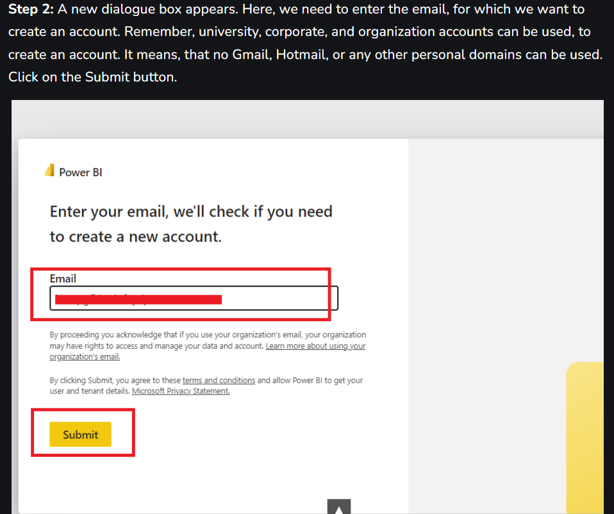

Slide 21
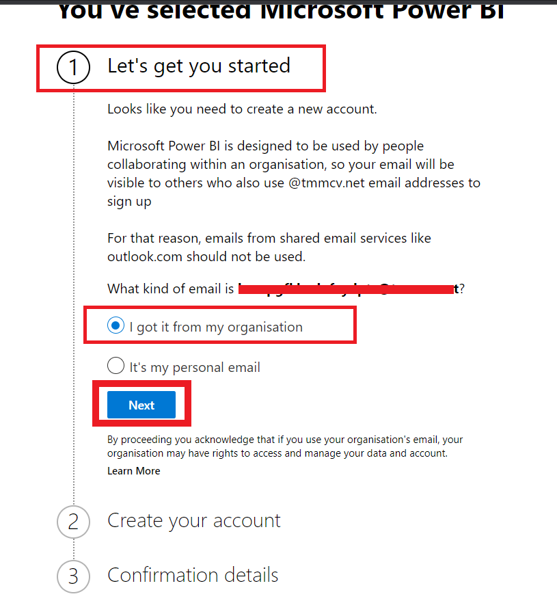
Step 3: The next page will open, it comprises three steps. The step1 is to get started, we need to select what type of email account we are using, either an organization account or a personal account.

Slide 22
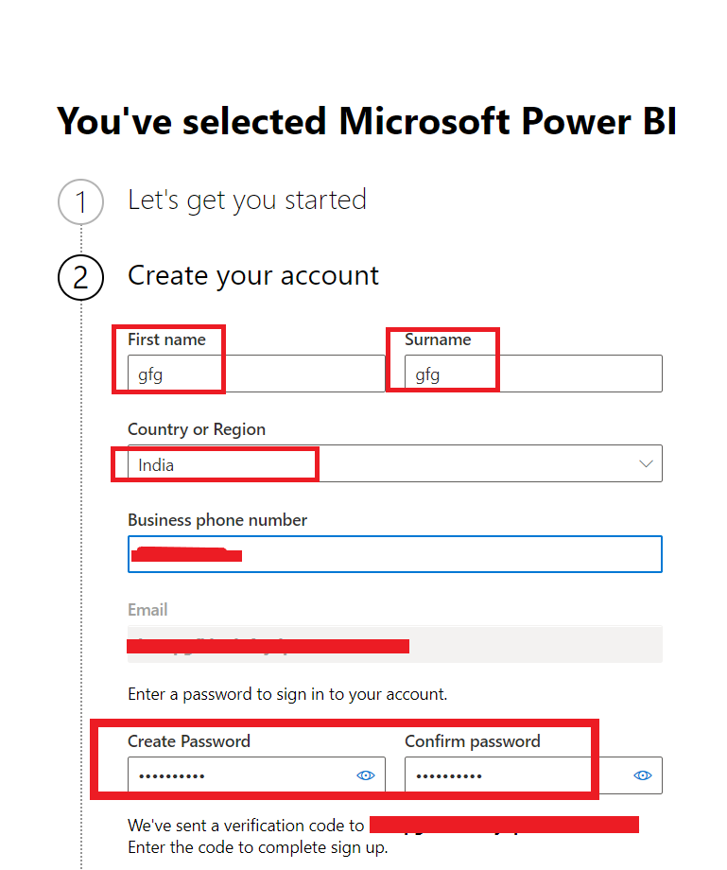
Step 4: Create your account. Fill in the required details as per said below. Enter your first name, surname, country of living, phone number, and strong password.

Slide 23
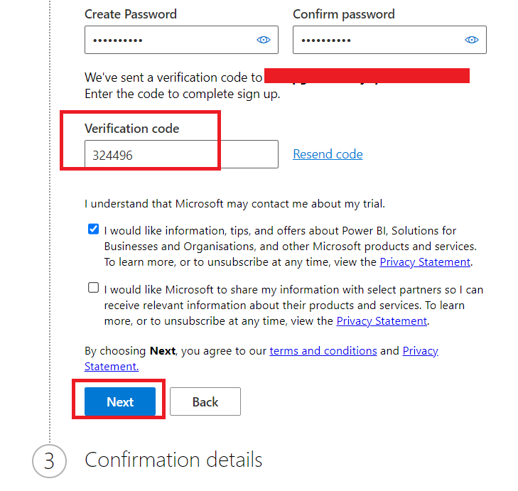
Step 5: A verification code will be sent to the entered email id, enter that verification code. Click on the Next button.

Slide 24
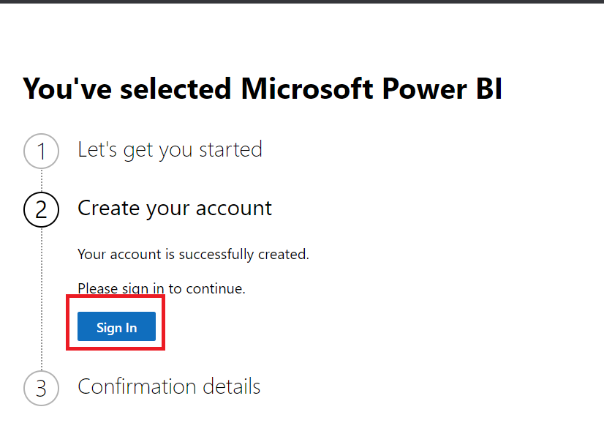
Step 6: Step2 is almost completed. Click on the Sign In button.

Slide 25
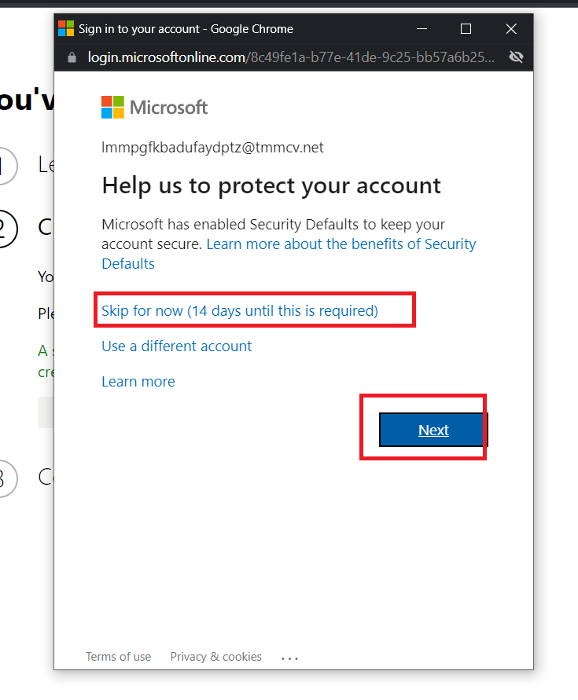
Step 7: A new dialogue box appears, which asks us to protect your account, we can skip this step for now. Note that this dialogue box could appear multiple times, so simply, click on the Skip for now button. Click on the Next button.

Slide 26
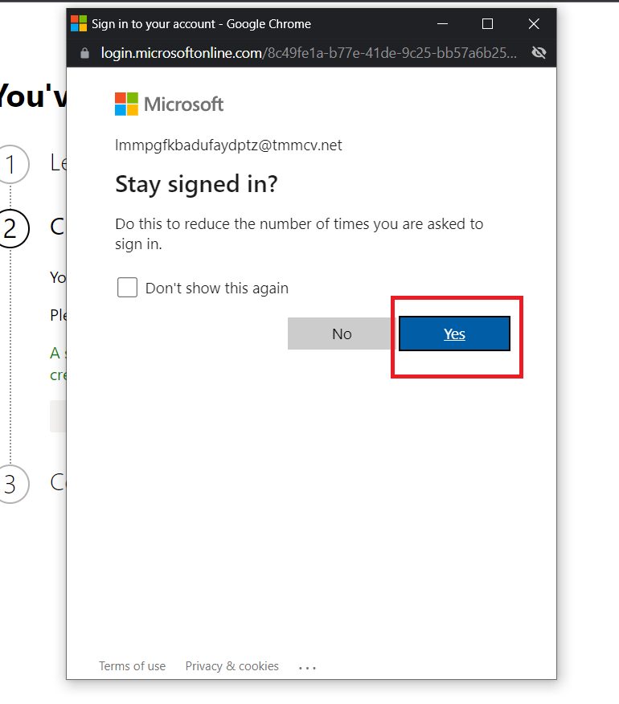
Step 8: A new dialogue box appears. Check the box, if you want to stay signed for long. Click on the yes button.

Slide 27
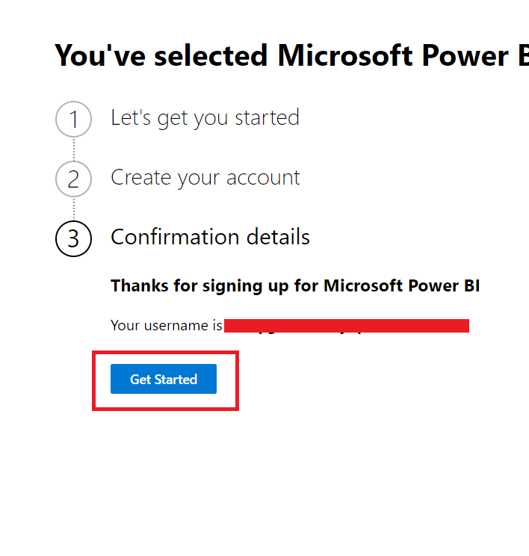
Step 9: Click on the Get Started button.

Slide 28
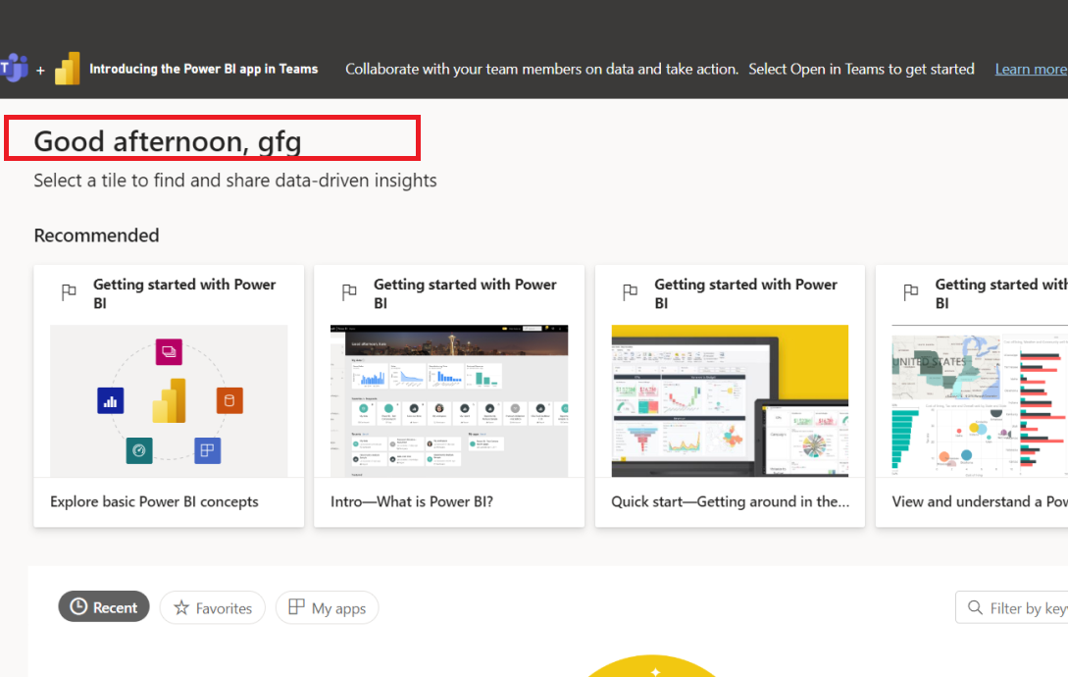
Step 10: We will be redirected to the home page of the Power BI online service. We have successfully created an account on the Power BI online service.

Slide 29
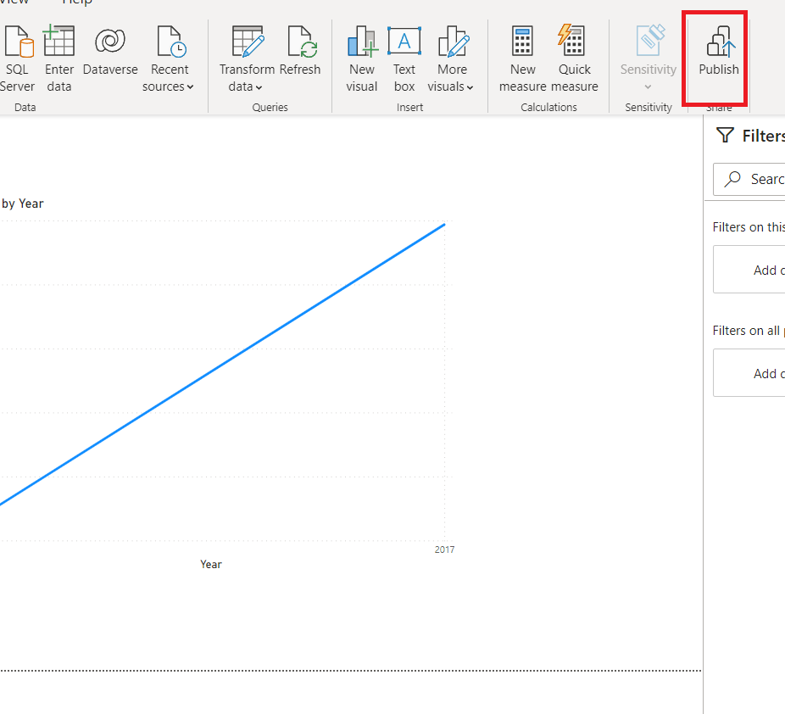
Publishing Report to Power BI Online Service from Desktop
Create a report then go to….

Slide 30
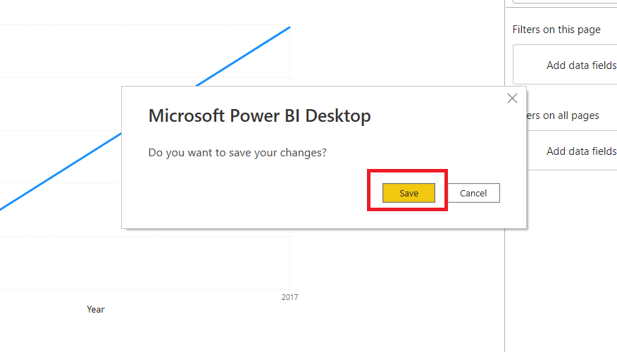
Step 2: A dialogue box appears. Click on the Save button, to save the required changes to the report.

Slide 31
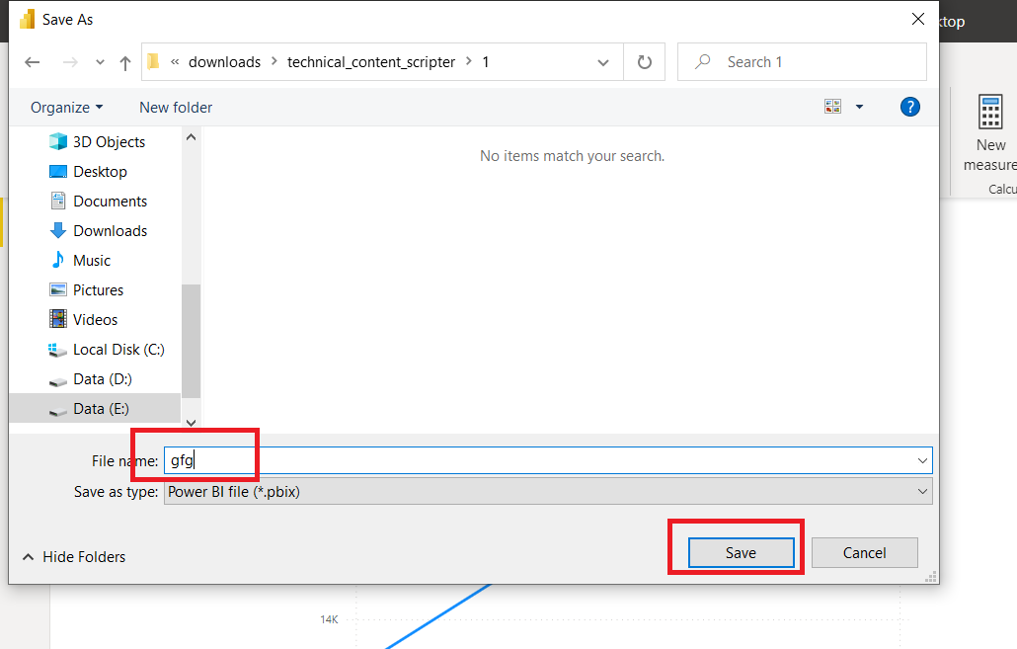
Step 3: Save the file, at your convenient location. Name the .pbix file. For example, gfg.pbix. Click on the Save button.

Slide 32
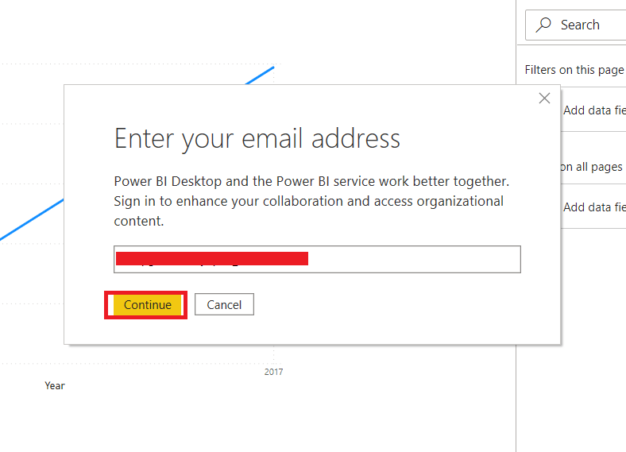
Step 4: A new dialogue box appears. Enter the email address, by which you created an account on the online service. Click on the Continue button.

Slide 33
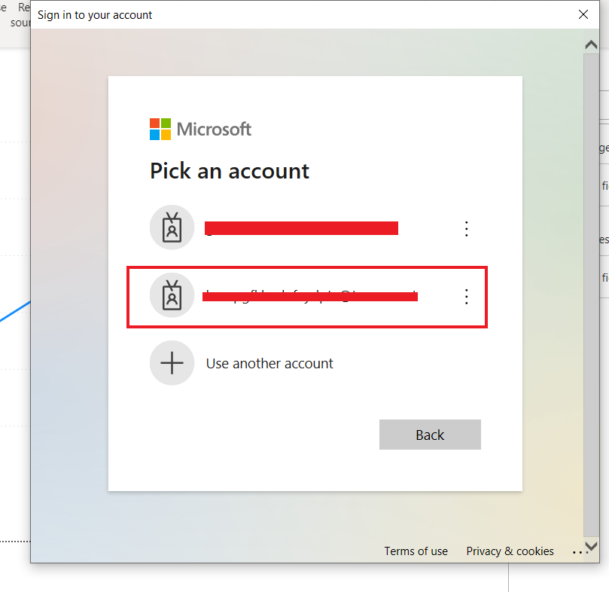
Step 5: All, the connected accounts, will be listed. Click on the desired account at which you want to save the file.

Slide 34
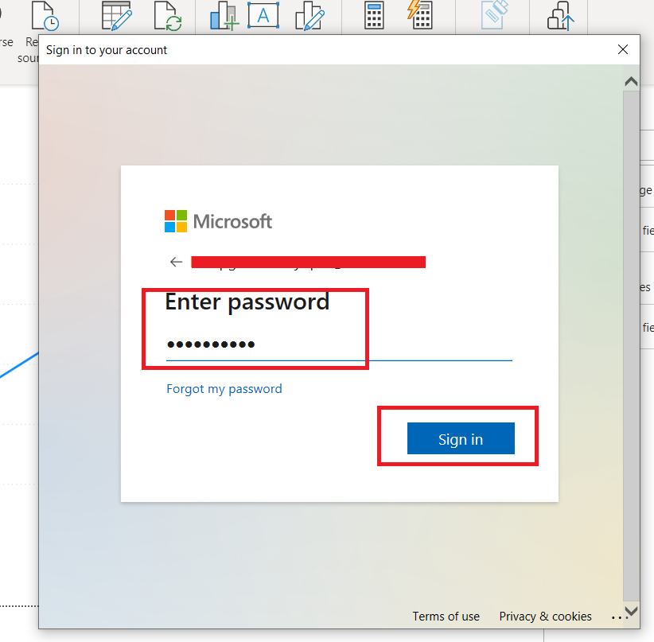
Step 6: Enter the password, for that Power BI online account. Click on the Sign-in button.

Slide 35
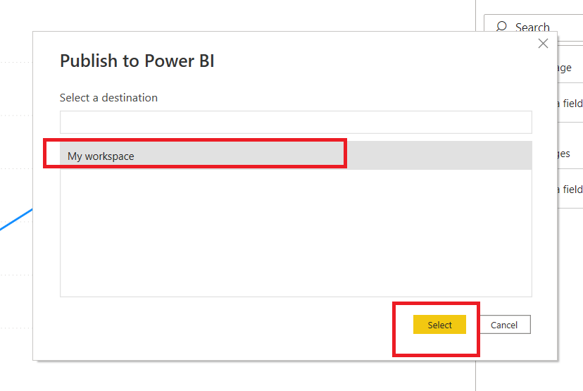
Step 7: Select the My workspace. Click on the Select button.

Slide 36
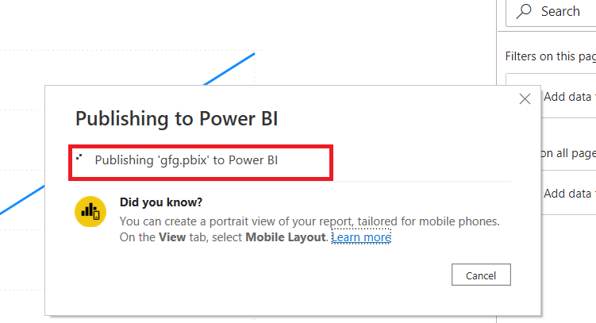
Step 8: The report will be published to the Power BI online service.

Slide 37
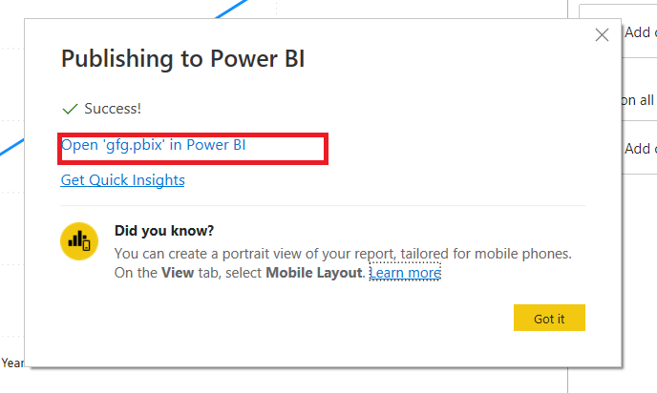
Step 9: Click on the Open ‘gfg.pbix’ in Power BI, to open the published file.

Slide 38
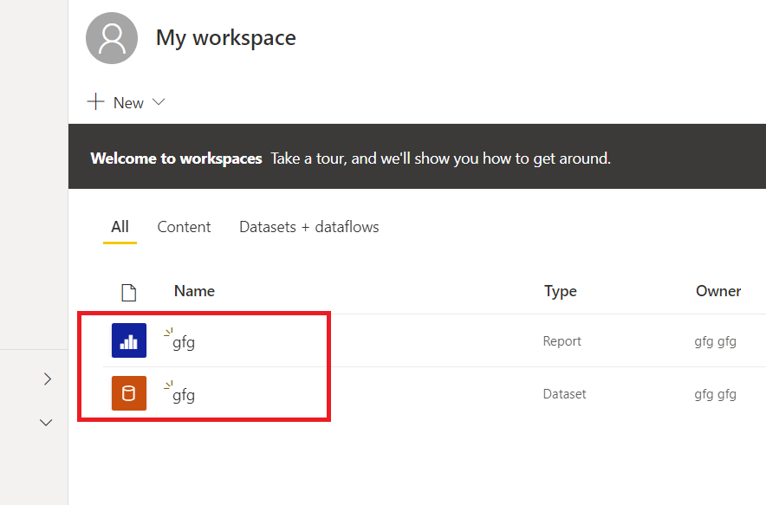
Step 10: The files have been successfully uploaded to the Power BI service. We have successfully connected the Desktop with the Power BI service.

Slide 39
Data Transformation and Modeling in Power BI
To get data ready for Power BI analysis, reshaping is a crucial step.
In order to make the data more suited for analysis, even if it is clear and of exceptional quality, you will frequently need to restructure it.
Fortunately, power query has a ton of features that can assist in doing this.
It is essential to understand that the same information can be represented in numerous ways using different dataset shapes.
The two most frequent shapes for datasets are long and wide.

Slide 40
A long dataset often only comprises one column with a numerical value and recurring categorical values in the first column.
A wide dataset, on the other hand, has several numerical columns, one for each variable, and only one column with unique values.
Power Query includes two transformations that allow us to change the structure of our dataset from long to wide and vice versa. These changes are known as pivoting and unpivoting.
Pivoting a table allows you to create additional columns in your dataset based on the values in a certain column.
The unpivot transformation, the inverse of the pivot transformation, allows us to select one or more columns to “flatten,” which converts the selected columns into a category-value pair.
This transformation will essentially convert your dataset from a wide to a long structure.

Slide 41
The Transpose table transformation is another Power Query transformation that reorganizes your data.
This transformation swaps your dataset’s rows with its columns and vice versa.
When working with a dataset, there are instances when you’ll wish to reduce its granularity and use a quick summary of it.
This is accomplished by using Power Query’s group by transformation.
When using group by, we define one or more columns that contain our desired grouping hierarchy and then use an aggregation function on the appropriate columns to generate statistics for those groups.

Slide 42
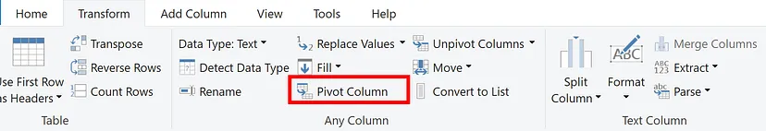
How to Pivot and Unpivot in Power BI
Click on the Category Name column and then on the Transform tab, we select Transform > Pivot Columns
We choose a column from the Values Column list on the Pivot Columns window that appears, such as Subcategory name.

Slide 43
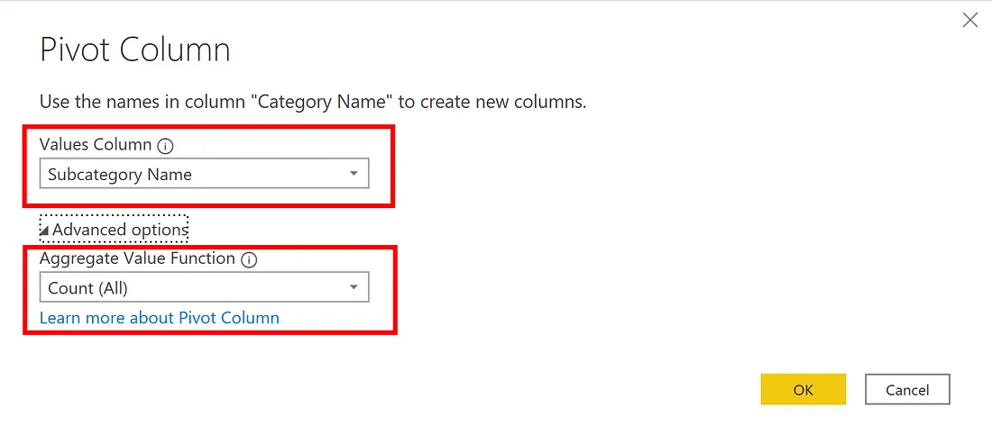

Slide 44
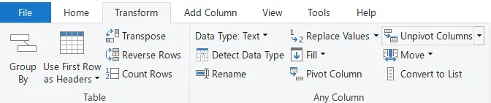
The Unpivot button appears as in the image below:
I’ll rename the Attribute column to Year and the Value column to SalesAmount.
Unpivoting simplifies the process of later constructing DAX measures on the data.

Slide 45
Data loading and shaping using Power Query Editor
Load the data in Power Query Editor by using the Transform data button in the Home tab.
After you load the data, select Table 1 from the available queries in the Queries pane.
When you shape data, you transform a data source into the form and format that meets your needs.
In Power Query Editor, you can find many commands in the ribbon, and in context menus.
For example, when you right-click a column, the context menu lets you remove the column. Or select a column and then choose the Remove Columns button from the Home tab in the ribbon.

Slide 46
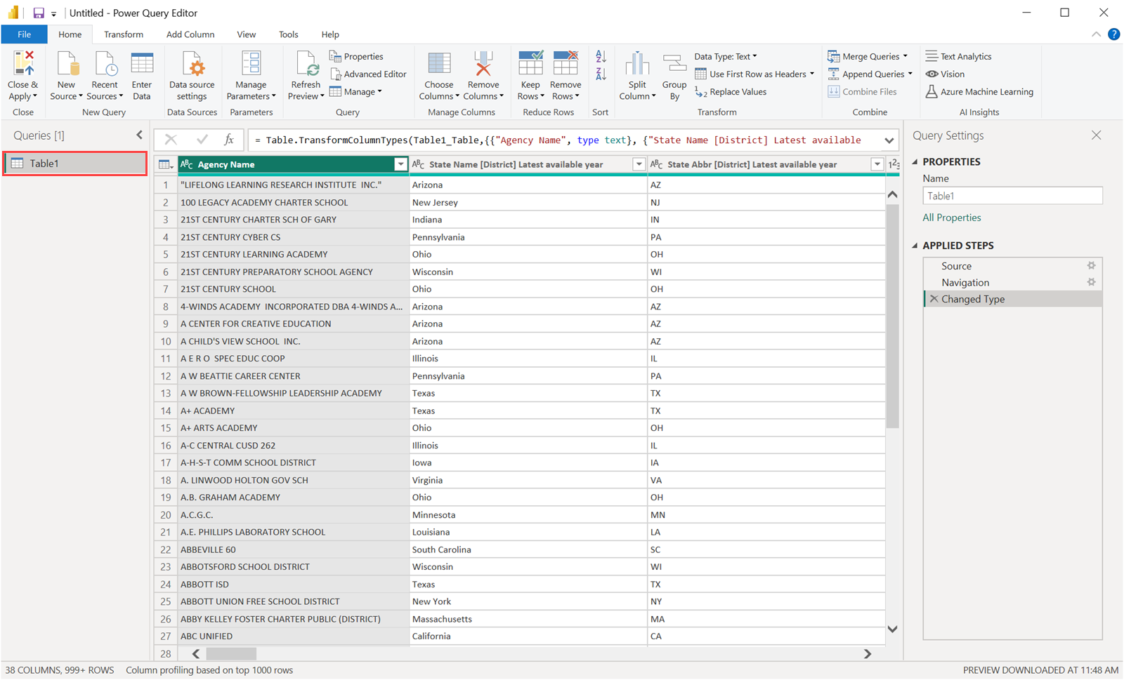

Slide 47
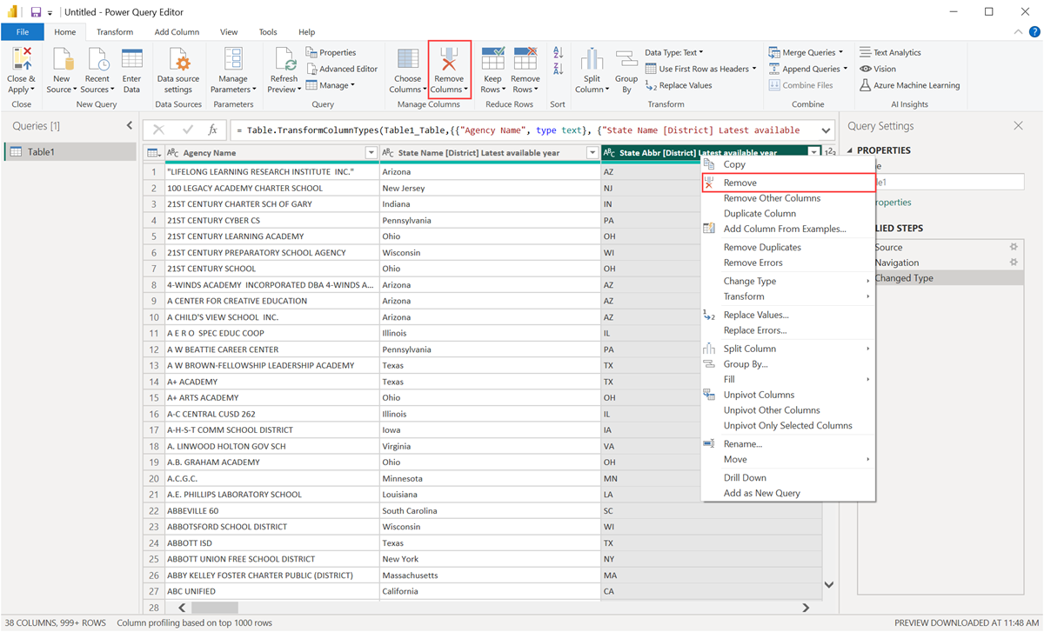

Slide 48
You can shape the data in many other ways in this query.
You can remove any number of rows from the top or bottom
Add columns
Split columns
Replace values, and do other shaping tasks.
With these features, you can direct Power Query Editor to get the data how you want it.

Slide 49
Data modeling and relationships
Power BI Model Relationships pass filters from one model table’s column to another.
Filters will propagate as long as there is a relationship path to follow, which could include multiple tables.
Filters are always propagated in the same way and without random variation along the relationship paths.
However, model calculations that use specific DAX functions can disable relationships or change the filter context of relationships in Power BI.
Data integrity is not enforced by Power BI model relationships.
With the help of an animated example, see how Power BI model relationships propagate filters.

Slide 50
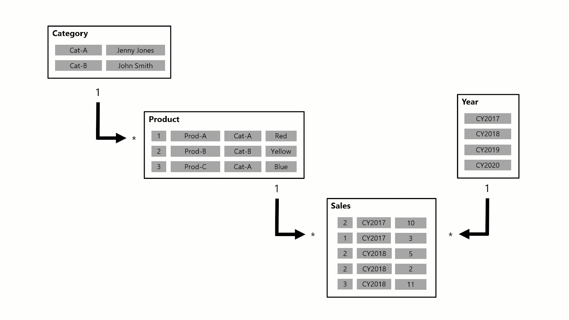

Slide 51
The model in this example contains four tables: Category, Product, Year, and Sales.
The Category table is linked to the Product table, which in turn is linked to the Sales table.
The Sales table is also linked to the Year table. Every relationship is one-to-many.
A query, possibly prompted by a Power BI card visual, asks for the total sales quantity for sales orders placed in a single category, Cat-A, and for a single year, CY2018.
That is why the Category and Year tables have filters applied.
The Category table’s filter propagates to the Product table, isolating two products belonging to the Cat-A category.

Slide 52
The filters from the Product table are then propagated to the Sales table, resulting in only two sales rows for these products.
The sales of products in category Cat-A are represented in these two sales rows. The total number of units they have is 14.
At the same time, the Year table filter propagates to the Sales table, leaving only one sales row for products in category Cat-A that were ordered in the year CY2018.
The query’s quantity value is 11 units. It’s worth noting that applying multiple filters to a table (such as the Sales table in this example) is always an AND operation, requiring that all conditions be true.

Slide 53
Calculated columns and measures
Measures and calculated columns both use DAX expressions.
You can compute values using calculated columns or using measures.
Calculated columns are computed based on data that has already been loaded into your data model.
When you write a calculated column formula, it is automatically applied to the whole table and evaluated individually for each row.
The values in calculated columns are evaluated when you first define them and when you refresh your dataset.

Slide 54
Once evaluated, the values are stored in your data model, which means your data model size increases and it consumes more RAM.
The more calculated columns you have the larger your model will become.
On the other hand, measures are computed at query time. A measure is stored in the model as source code, but it is computed only when it is used in the report.
Measures are evaluated in the filter context of the visual in which they are applied.

Slide 55
The filter context is defined by the filters applied in the report such as row selection, column selection, report filters and slicers applied.
Measures are only evaluated at the level of granularity they are plotted at.
As calculated columns are computed when you first define them/ when you refresh your dataset, they do not have access to the filter context.
Calculated columns are calculated outside of the filter context and do not depend on user interaction in the report.

Slide 56
DAX (Data Analysis Expressions) language fundamentals
DAX (Data Analysis Expressions) is a formula expression language and can be used in different BI and visualization tools.
DAX is also known as function language, where the full code is kept inside a function.
DAX programming formula contains two data types: Numeric and Other.
Numeric includes - integers, currency and decimals
Other includes: string and binary object.

Slide 57
DAX Functions
It includes functions from different categories such as −
Aggregate
Text
Date
The start-date and end-date arguments could be any DateTime value. It returns the table of a single column with a set of dates. Syntax: CALENDAR(<StartDate>,<EndDate>) Example: COUTDAYS(CALENDAR(DATE(2020,4,1), DATE(2020,6,5))) //returns 65
Logical
The AND function checks if both arguments are True or False. It will return True if only if both arguments are true, otherwise it will return False. Syntax: AND(<argument1>, argument2)
Counting
Information

Slide 58
DAX Functions in Power BI are the predefined formulas used to calculate the arguments in a function, executed in a particular order.
The functions perform particular operations on one or more arguments in a DAX formula. Below are the key points of DAX functions:
DAX functions in Power BI will never refer to individual values, they always refer to a complete field, column, or table.
However, you have to create filters inside the DAX formula, if you want to use DAX functions on individual values.
DAX functions can also be applied for separate rows without any filters. The calculations can be applied based on the context of each row.
DAX uses the time intelligence function to calculate the time and date ranges.
These functions can sometimes return the entire table, which can be used as an input for other DAX functions in Power BI. However, the user cannot display these output tables returned by the functions.

Slide 59
Creating Interactive Reports and Dashboards in Power BI:
Understanding the Importance of Interactive Dashboards
Interactive dashboards have their ability to give users instant access to actionable insights.
Interactive dashboards enable users to drill down into data, view different metrics, and perform various data analysis operations on the fly.
They are also a great way to enable collaboration, as they allow multiple stakeholders to view and interact with data simultaneously.

Slide 60
One of the key benefits of interactive dashboards is their ability to provide real-time data updates.
This means that users can access the most up-to-date information at any given time, allowing them to make informed decisions quickly.
Additionally, interactive dashboards can be customized to meet the specific needs of different users, making them a versatile tool for businesses of all sizes and industries.
Another advantage of interactive dashboards is their ability to identify trends and patterns in data.
By using interactive visualizations, users can easily spot trends and patterns that may not be immediately apparent in raw data.
This can help businesses to identify opportunities for growth and improvement, as well as potential areas of concern that may need to be addressed.

Slide 61
Choosing the Right Data Sources for Your Dashboard
The success of your Power BI dashboard depends largely on the quality and relevancy of the data sources you choose. When selecting data sources, consider the following factors:
Reliability and accuracy of the data
Timeliness of the data
Availability and accessibility of the data
Security and privacy of the data
compatibility of the data with our dashboard's design and layout.
consider the scalability of your data sources.

Slide 62
Design Tips for Creating Effective and Engaging Dashboards
When designing your Power BI dashboard, keep the following tips in mind:
Choose the right chart type for your data
Use colors effectively to highlight important data points
Keep the dashboard simple and easy to read
Use filters and slicers to enable interactivity
Make sure the dashboard is optimized for the devices it will be viewed on
Data is presented in a logical and intuitive manner (This means that the layout of the dashboard should be organized in a way that makes it easy for the user to understand the relationships between different data points.)
If the dashboard is intended for a broader audience, it may be necessary to include more general information that is easily understandable by everyone.

Slide 63
Advanced Features like Filters, Slicers
Filters and slicers are powerful tools that allow users to focus on specific data points in a dashboard.
Filters can be applied to individual visuals or to the entire dashboard, while slicers enable users to filter data across multiple visuals at once.
These advanced features can help users gain deeper insights and make more informed decisions based on their data.

Slide 64
To create an interactive dashboard in Power BI, follow these steps:
Connect to your data sources
Create a new dashboard
Choose the visualizations you want to include
Configure the visualizations using the formatting options
Save and share your dashboard with others
It's important to note that when creating an interactive dashboard in Power BI, you should consider the audience who will be using it.
Think about what data is most relevant to them and how they will want to interact with it.
Additionally, you can use Power BI's built-in features such as filters, slicers, and drill-throughs to enhance the interactivity of your dashboard and make it more user-friendly.

Slide 65
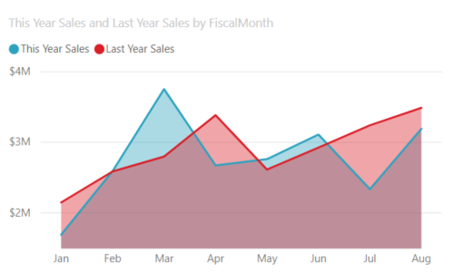
Visualizations and chart types
Area charts: Basic (Layered) and Stacked
The basic area chart is based on the line chart with the area between the axis and line filled in.
Area charts emphasize the magnitude of change over time, and can be used to draw attention to the total value across a trend.
For example, data that represents profit over time can be plotted in an area chart to emphasize the total profit.

Slide 66
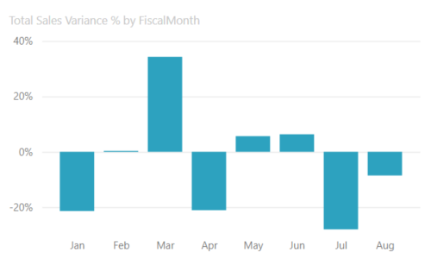
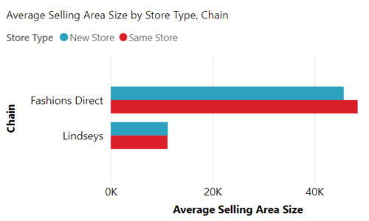
Bar and column charts

Slide 67
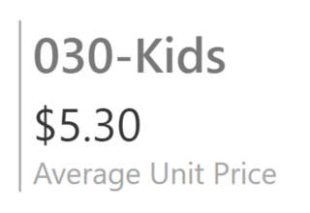
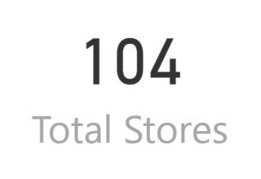
Cards
Multi row - Multi row cards display one or more data points, one per row.
Single number
Single number cards display a single fact, a single data point.
Sometimes a single number is the most important thing you want to track in your Power BI dashboard or report, such as total sales, market share year over year, or total number of sections.

Slide 68
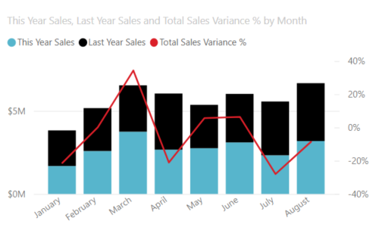
Combo charts
A combo chart combines a column chart and a line chart.
Combining the two charts into one lets you make a quicker comparison of the data.
Combo charts can have one or two Y axes, so be sure to look closely.
Combo charts are a great choice:
When you have a line chart and a column chart with the same X axis.
To compare multiple measures with different value ranges.
To illustrate the correlation between two measures in one visual.
To check whether one measure meets the target which is defined by another measure.
To conserve canvas space.

Slide 69
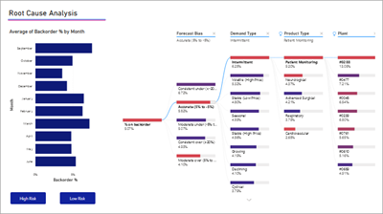
Decomposition tree
The decomposition tree visual lets you visualize data across multiple dimensions.
It automatically aggregates data and enables drilling down into your dimensions in any order.
It is also an artificial intelligence (AI) visualization, so you can ask it to find the next dimension to drill down into based on certain criteria.
This makes it a valuable tool for ad hoc exploration and conducting root cause analysis.

Slide 70
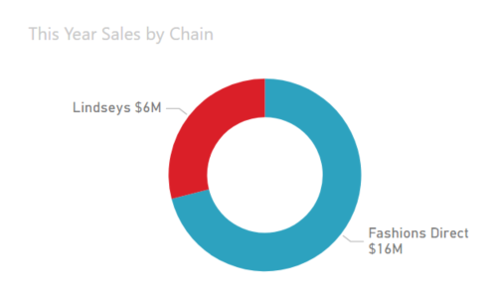
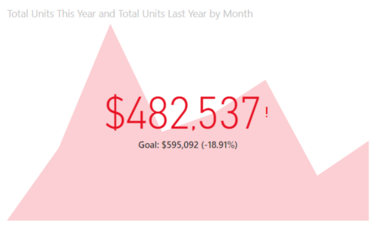
Doughnut charts
Doughnut charts are similar to pie charts.
They show the relationship of parts to a whole.
The only difference is that the center is blank
and allows space for a label or icon.
KPIs
A Key Performance Indicator (KPI) is a visual
cue that communicates the amount of progress
made toward a measurable goal.
KPIs are a great choice:
To measure progress
(what am I ahead or behind on?).
To measure distance to a metric.

Slide 71
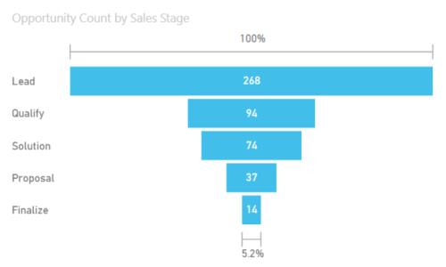
Funnel charts
Funnels help visualize a process that has stages, and items flow sequentially from one stage to the next.
For example, a sales funnel that tracks customers through stages: Lead > Qualified Lead > Prospect > Contract > Close.
At a glance, the shape of the funnel conveys the health of the process you're tracking.
Each funnel stage represents a percentage of the total. So, in most cases, a funnel chart is shaped like a funnel -- with the first stage being the largest, and each subsequent stage smaller than its predecessor.
A pear-shaped funnel is also useful -- it can identify a problem in the process.
But typically, the first stage, the "intake" stage, is the largest.

Slide 72
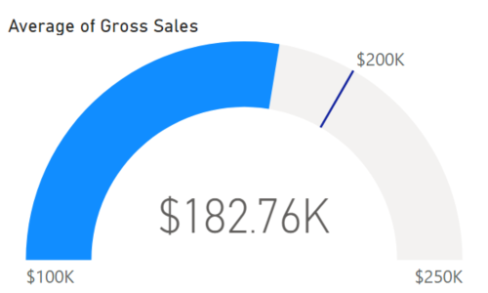
Gauge charts
A radial gauge chart has a circular
arc and displays a single value that
measures progress toward a goal.
The goal, or target value, is
represented by the line (needle).
Progress toward that goal is represe-
nted by the shading.
Radial gauges are a great choice to:
Show progress toward a goal.
Represent a percentile measure, like a KPI.
Show the health of a single measure.
Display information that can be quickly scanned and understood.

Slide 73
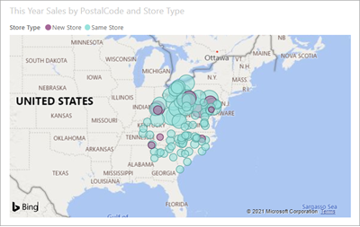
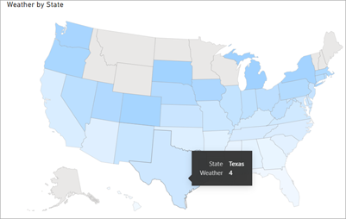
Maps
Basic map
Use a basic map to associate both categorical and quantitative information with spatial locations.
Shape map
Shape maps compare regions on a map using
color.
A shape map can't show precise geographical
locations of data points on a map.
Instead, its main purpose is to show relative
comparisons of regions on a map by coloring
them differently.

Slide 74
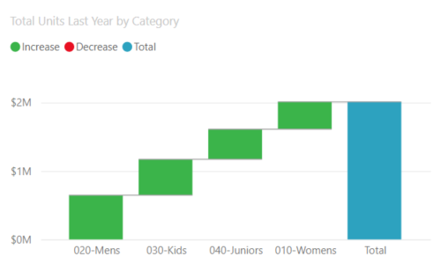
Waterfall charts
A waterfall chart shows a running total as values are added or subtracted.
It's useful for understanding how an initial value (for example, net income) is affected by a series of positive and negative changes.
Waterfall charts are a great choice:
When you have changes for the measure across time or across different categories.
To audit the major changes contributing to the total value.
To plot your company's annual profit by showing various sources of revenue and arrive at the total profit (or loss).
To illustrate the beginning and the ending headcount for your company in a year.
To visualize how much money you make and spend each month, and the running balance for your account.

Slide 75
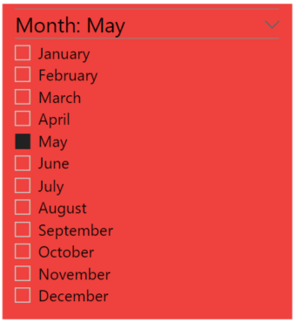
Slicers
A slicer is a standalone chart that can be used to filter the other visuals on the page. Slicers come in many different formats (category, range, date, etc.) and can be formatted to allow selection of only one, many, or all of the available values.
Slicers are a great choice to:
Display commonly used or important filters on the report canvas for easier access.
Make it easier to see the current filtered state without having to open a drop-down list.
Filter by columns that are unneeded and
hidden in the data tables.
Create more focused reports by putting
slicers next to important visuals.

Slide 76
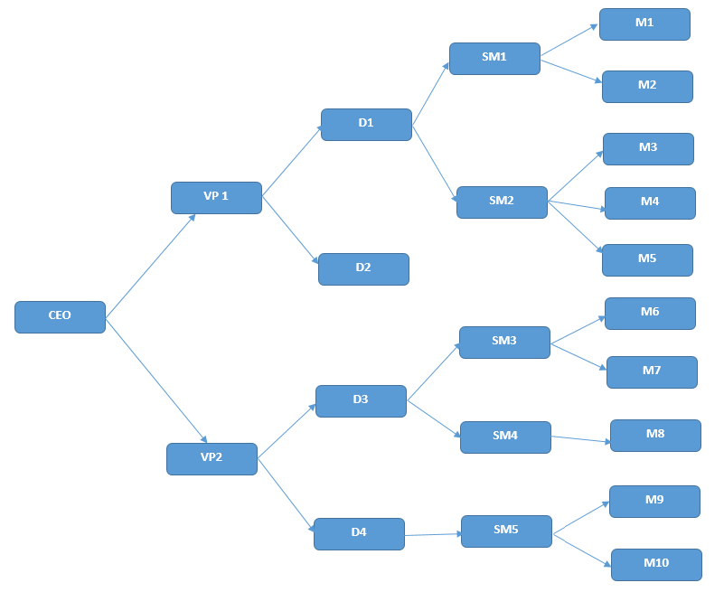
Hierarchies

Slide 77
Hierarchies in Power BI are a way to organize data in a hierarchical structure, where one parent or first level is ranked over the other.
This allows users to drill down from parent levels to lower levels in a specific order.
Authority ensures that everyone under a manager's command will work towards the organisation's goals — or face discipline.
History has shown that without hierarchical authority, teams are much less likely to unite to achieve a common goal.

Slide 78
formatting and customization options
In Power BI reports, you can change the color of data series, data points, and even the background of visualizations.
You can change how the x-axis and y-axis are presented.
You can even format the font properties of visualizations, shapes, and titles.
Power BI provides you with full control over how your reports appear.
Importance of formatting and customization options
to make it easier for Power BI to categorize
easier for Power BI to identify data
making it considerably easier to work with.

Slide 79
Use report themes in Power BI Desktop
you can apply design changes to your entire report
such as using corporate colors
changing icon sets
applying new default visual formatting.
When you apply a report theme, all visuals in your report use the colors and formatting from your selected theme as their defaults.
The two types of report themes:
Built-in report themes provide different kinds of predefined color schemes.
You select built-in report themes directly from the Power BI Desktop menu.
Custom report themes provide granular control over many aspects of a report theme.

Slide 80
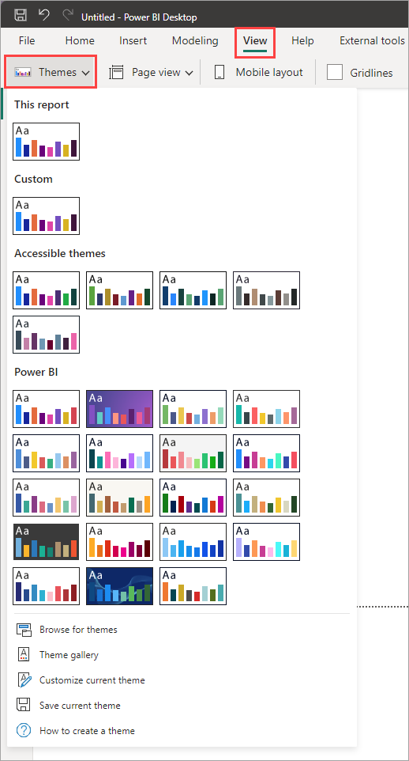

Slide 81
Drill-Down Report: Meaning
Viewing consolidated data in more detail is known as drilling down.
A report that allows the user to navigate a hierarchical relationship between data is known as a drill-down report.
For example, when a user clicks on a visualization, this report allows the user to view a granular level of data so that they can identify how the data was generated.

Slide 82
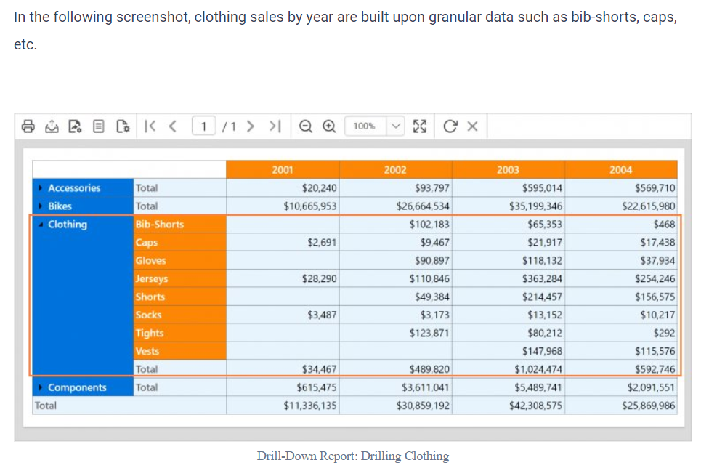

Slide 83
Drill-Through Report: Meaning
Viewing a different layer of data by clicking a visualization element is known as drilling through.
Drilling through allows a user to understand another aspect of data that is related to the current data.
It doesn’t show a granular view of the current data; instead, it shows a new way to analyze the current data.

Slide 84
